Slide 1

Towards a Cheap and Environmentally Friendly Polymer Based Battery
Andreas Grasser, 13.12.2021

Slide 2

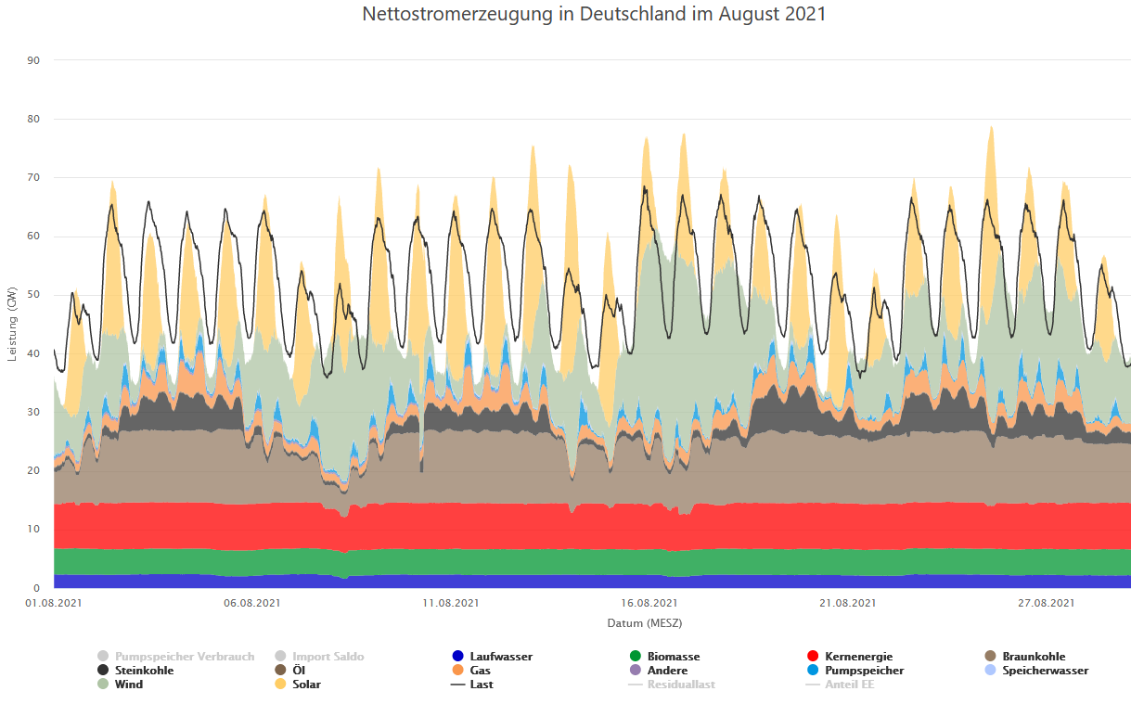
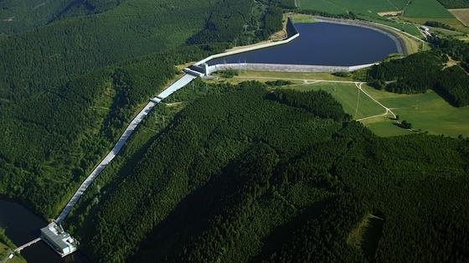
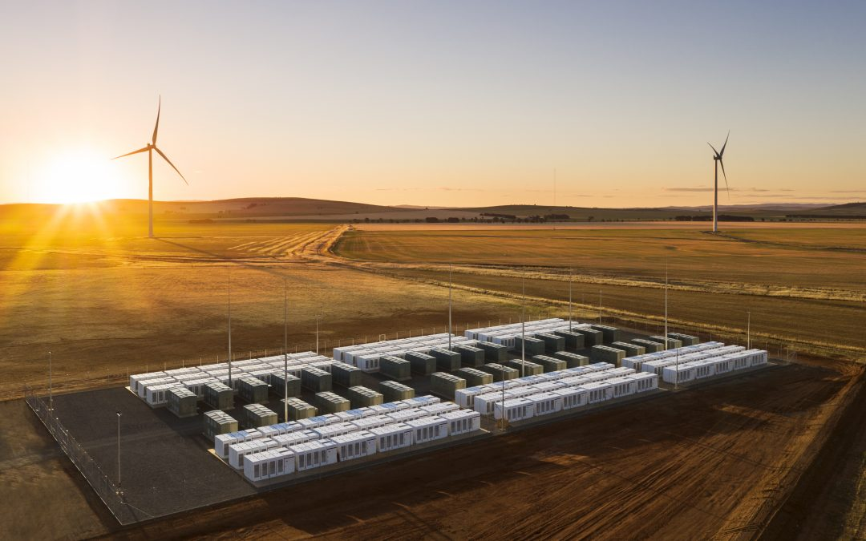
Motivation
Large fluctuations in the production of renewable energy
→ Need for the storage of large amounts of energy
Fraunhofer ISE (energy-charts.info)

Slide 3
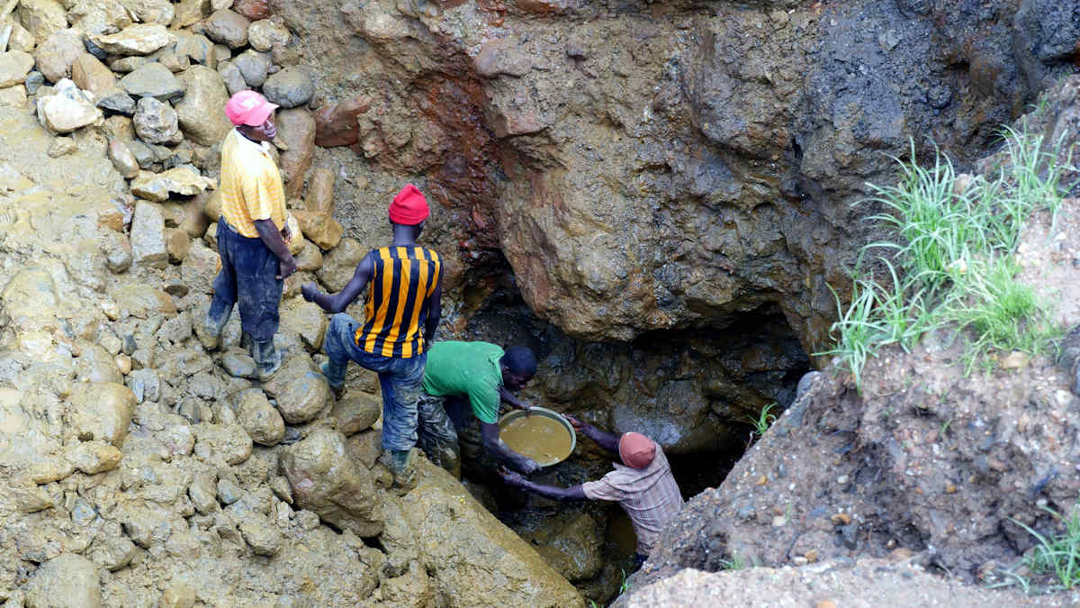

Motivation
Environmental and humanitarian issues of traditional Li-Ion batteries
Dangerous, flammable organic electrolytes
For stationary applications energy density is no big problem
Sodium-ion batteries
Cobalt Mine in the Congo

Slide 4
Motivation
Electrodes | Electrolyte
Cheap | Cheap
Environmentally friendly | Safe
Good stability | Large stability window
… | …
+ current collectors

Slide 5
Electrode

Slide 6
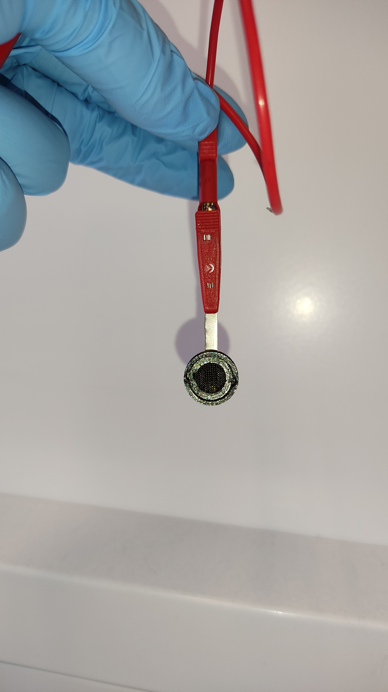
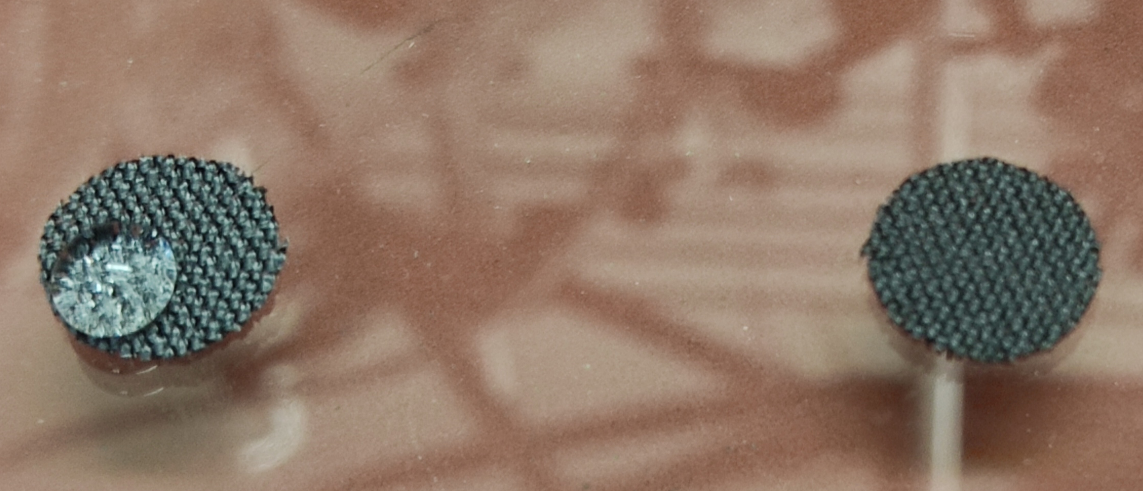
Carbon Cloth Current Collectors
Flexible carbon-based current collector
Normally hydrophobic
After 2M H₂NO₃ treatment: hydrophilic
3D-printed holder with titanium contact
untreated
after treatment

Slide 7
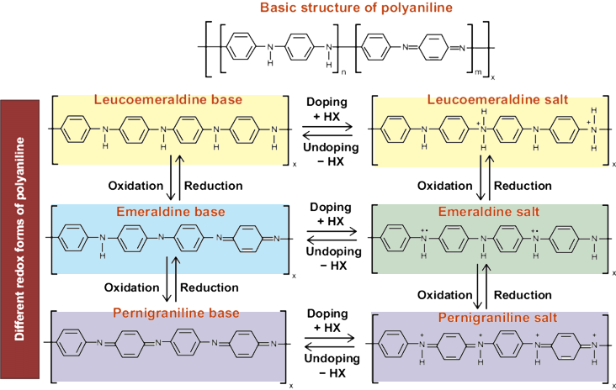
Polyaniline as Electrode Material
Cheap polymer
Environmentally friendly
Charge storage through adsorption
Emeraldine salt conductive → conductive coatings
Two redox peaks

Slide 8
Polyaniline as Electrode Material
Preparation of the electrodes:
H₂NO₃-treated carbon cloth as substrate
Dropcasting 25µl of NMP-PANI onto the carbon cloth
→ Mass loading: ~0.35mg
Drying at ~100°C

Slide 9
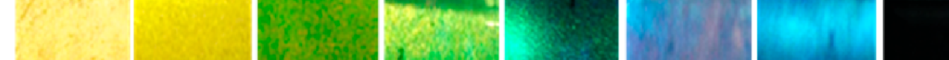
Polyaniline as Electrode Material
Cheap polymer
Environmentally friendly
2 redox peaks
Better peak separation and higher capacity in HCl acid → Due to H⁺ adsorption or due to PANI salt state?
Vs. Ag/AgCl

Slide 10
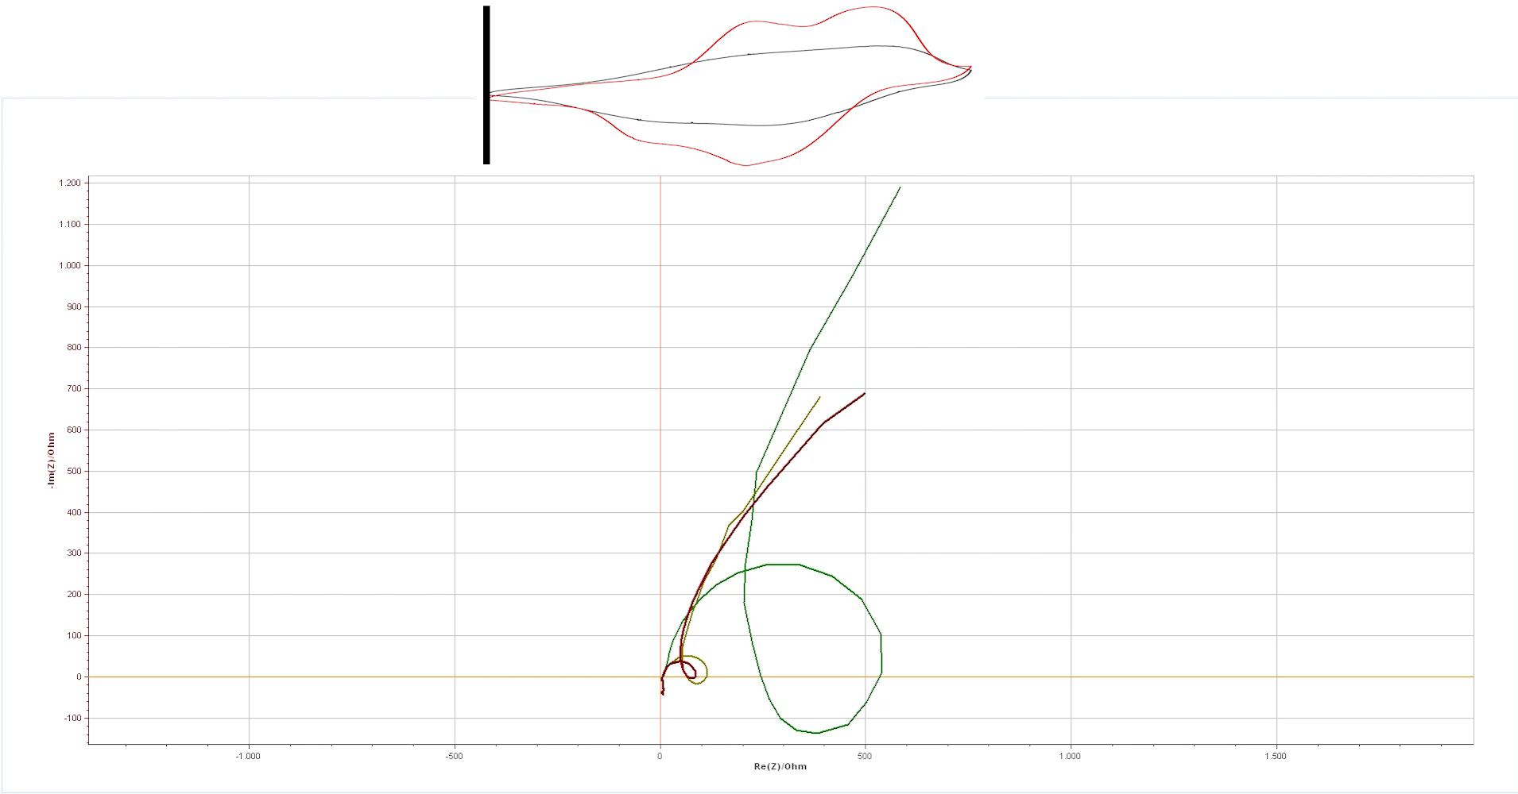
Polyaniline as Electrode Material
8M NaClO4
0.5M HCl
8M NaClO4
+ 0.5M HCl
(15:1)

Slide 11
Electrolyte

Slide 12
Stability Window of the Electrolyte
Aqueous electrolytes have a relatively low stability window

Slide 13
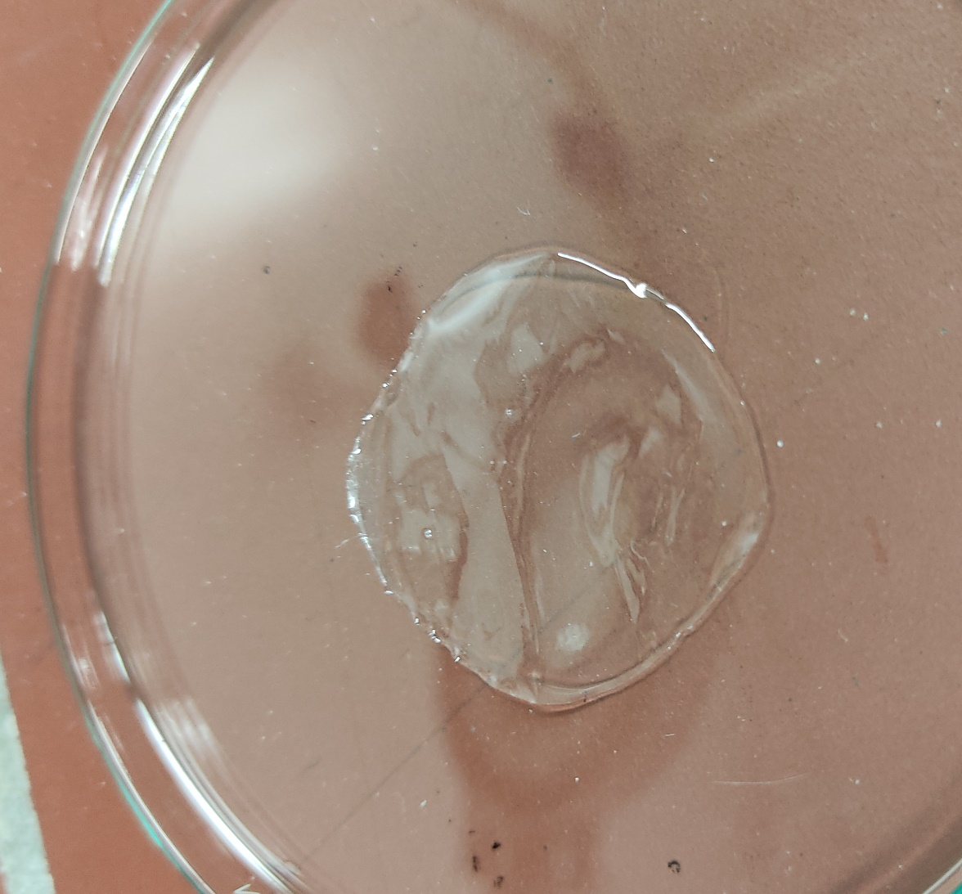
Solid State (Polymer) Electrolytes
e.g. Polyvinyl Alcohol (PVA)
+ also acts as a separator
- poor conductivity

Slide 14

Water Based Electrolytes
Concentrated aqueous electrolyte
Mixed organic-aqueous electrolytes
Hydrate melt
Gel Electrolyte

Slide 15
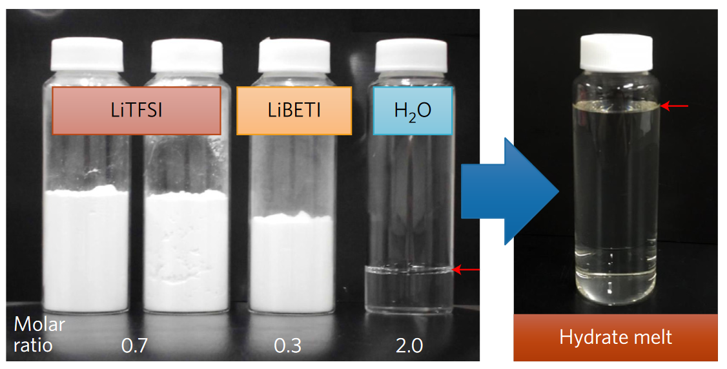
Water Based Electrolytes
Concentrated aqueous electrolyte
Mixed organic-aqueous electrolytes
Hydrate melt
Gel Electrolyte
Yamada, Y., Usui, K., Sodeyama, K. et al. Hydrate-melt electrolytes for high-energy-density aqueous batteries.

Slide 16
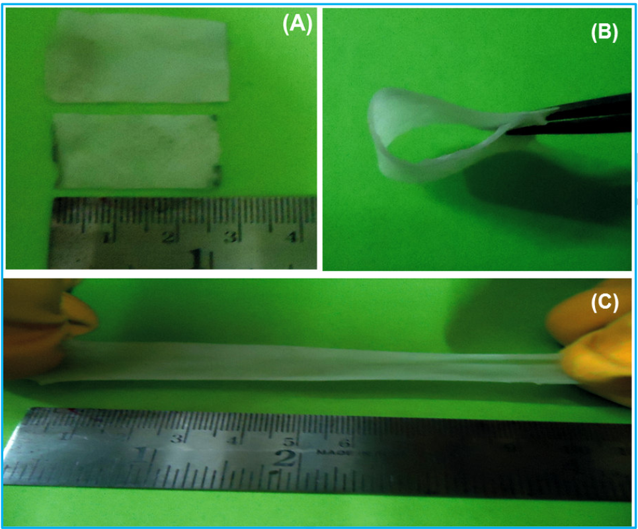
Water Based Electrolytes
Concentrated aqueous electrolyte
Mixed organic-aqueous electrolytes
Hydrate melt
Gel Electrolyte
N.R. Chodankar, D.P. Dubal,A.C. Lokhande, C.D. Lokhande,
Ionically Conducting PVA-LiClO4 Gel Electrolyte for High PerformanceFlexible Solid State Supercapacitors

Slide 17
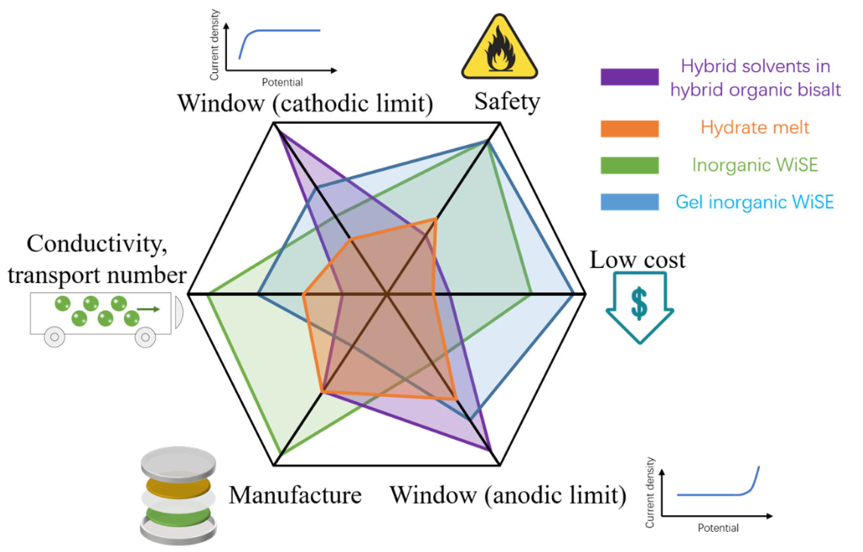
Water Based Electrolytes
Gel electrolytes are good candidates for cheap and safe batteries

Slide 18
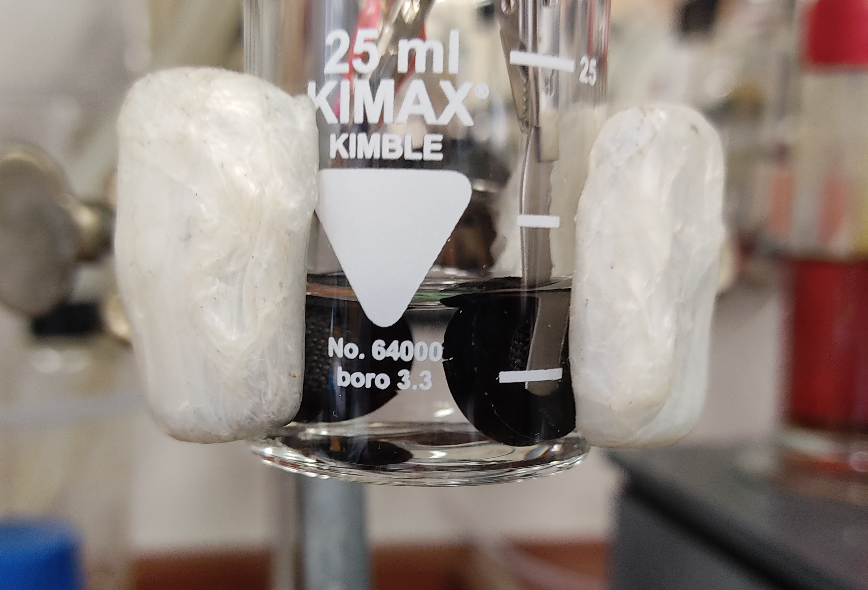
Gel Electrolyte using PVA
Good solubility in water
Cheap
Environmentally friendly

Slide 19
Problem of Carbon Cloth Surface Oxides
Full CV over the whole stability window not possible due to surface oxides
Two half CVs over several cycles

Slide 20
Problem of Carbon Cloth Surface Oxides
Full CV over the whole stability window not possible due to surface oxides
Two half CVs over several cycles
1st cycle
2nd cycle

Slide 21
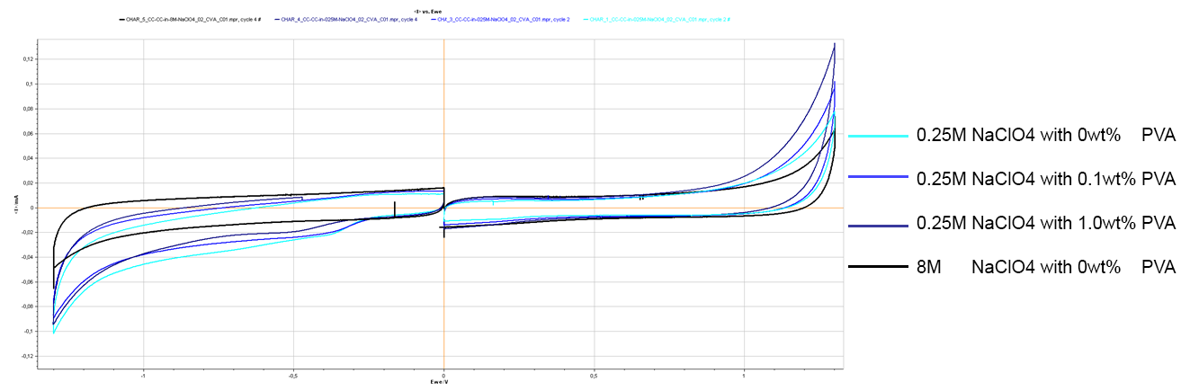
Gel Electrolyte using PVA
With low concentrations of PVA no larger stability window visible

Slide 22
Gel Electrolyte using PVA
With low concentrations of PVA no larger stability window visible
No real gel electrolyte
Larger amount of PVA necessary

Slide 23
Further Plans and Current Problems
For gel electrolyte: no Ag/AgCl-reference electrode possible
Oversized (NiHCF) counter electrode?
Compare different ways of PANI coating:
Electropolymerisation of aniline (thin films)
Slurry mixing (larger mass loading)

